Slide 1
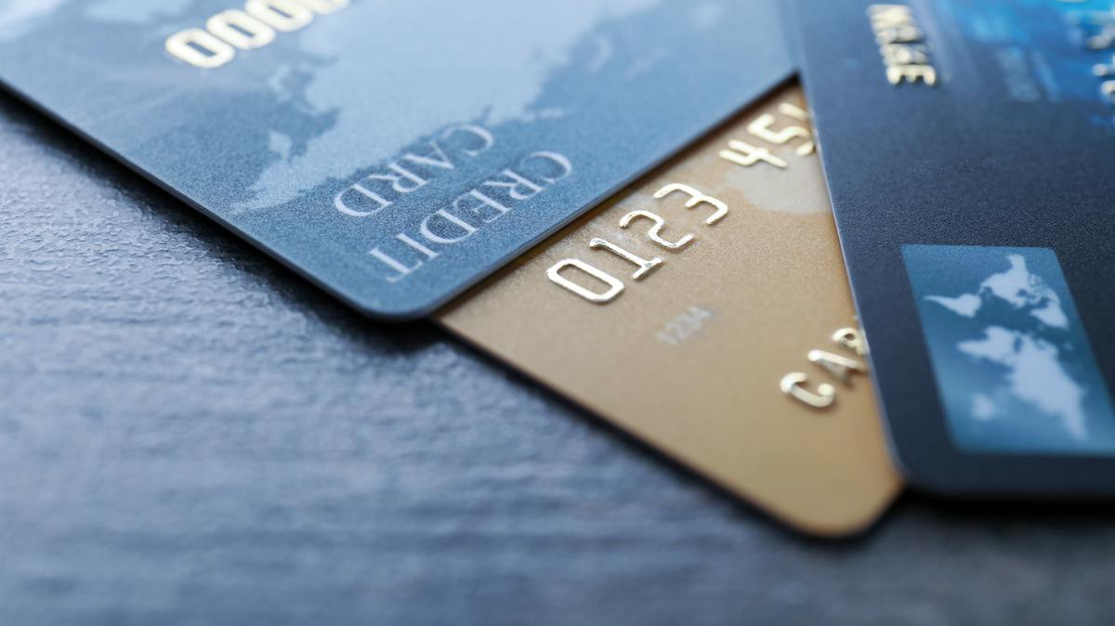
Credit Card Fraud Detection
Barbara Vargas and Mauricio Bock

Slide 2
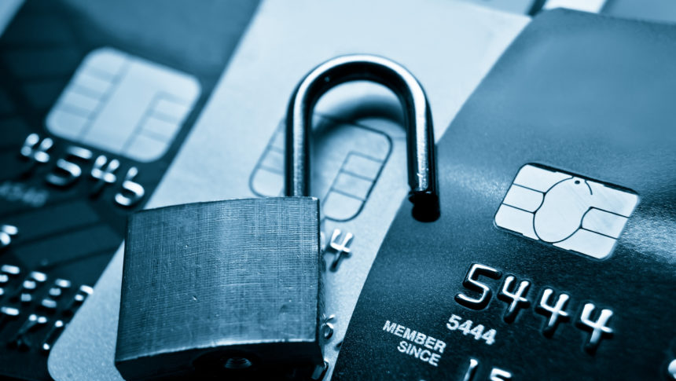
Agenda
Background
About the Dataset
Insights
Outcome & Results

Slide 3





Background: Credit Card Fraud Detection
Company Losses due to Fraud
How Frauds are Recognized
Deviating from regular buying pattern or time
Large number of Txs in short period of time
Purchases made from different states
Suddenly costly items are purchased

Slide 4

About the Dataset
About the data:
Simulated credit card transaction dataset
Includes legitimate and fraudulent transactions
Timeframe includes Transactions from 1st Jan 2019 - 31st Dec 2020.
Covers credit cards numbers of 1000 customers doing transactions with a pool of 800 merchants.
Our Dataset had:
1.852.394 Transactions
9651 Transactions are Fraudulent (0.521% in Total)
The Challenges with the Dataset:
Imbalanced Data
Most of the generated categorical Data is not useful

Slide 5

Insights: How Frauds are recognized

Slide 6

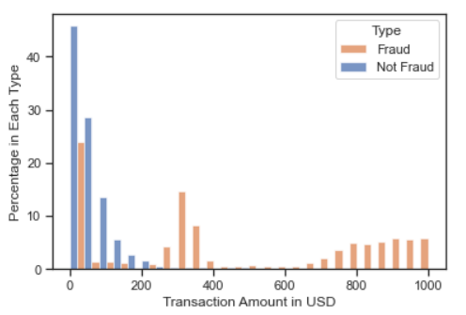
Observation: How much do regular customer vs. Scammer spend?
Amount($) vs. Fraud
While normal transactions tend to be around 200 Dollars or less, we see fraudulent transactions peak around 300 Dollars and then at the 800-1000 Dollars range.
$300
$900

Slide 7
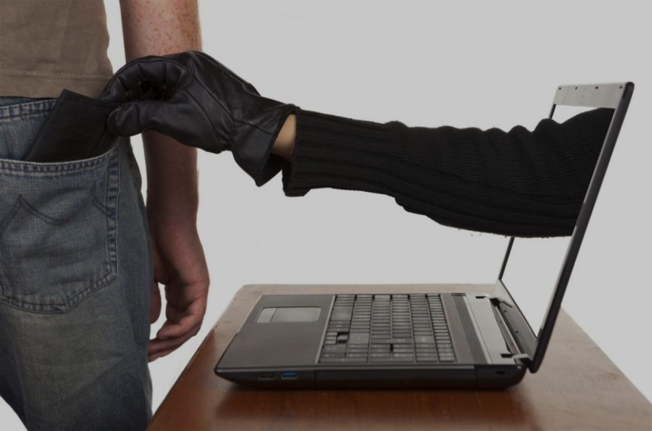
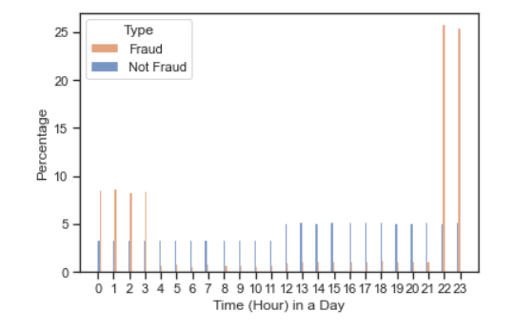


Observation: When do regular transactions take place vs. fraudulent transactions?
Normal Transaction Times vs. Fraudulent Transaction Times
Fraudulent transactions are happening mainly at night, when the victims are sleeping or are less likely to notice the fraud.
Time to rob!
Thief is sleeping

Slide 8

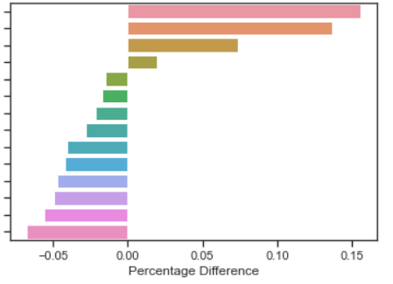
Observation: Is there a difference of fraudulent over non-fraudulent transactions in each category?
Shopping Online
Grocery Offline
Misc Online
Shopping Offline
Travel
Grocery Online
Gas / Transport
Misc Offline
Personal Care
Entertainment
Health / Fitness
Food / Dining
Kids / Pets
Home
The Percentage Difference of Fraudulent over
Non-Fraudulent Transactions made in Each Spending Category
Fraudulent over Non-Fraudulent transaction in Online Shopping and Offline Grocery Shopping categories increased over 10% to 15% in comparison to other category spendings.
The Percentage Difference

Slide 9
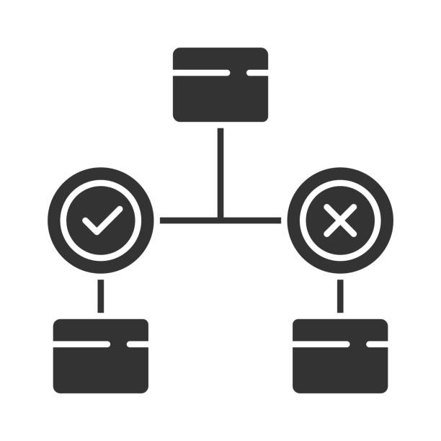
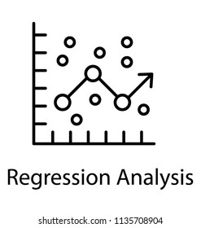

MACHINE LEARNING
Choose A Model!
Good RECALL EQUALS good DETECTION
Decision Trees
Logistic Regression
Random Forest
Recall
Recall
Recall
Train
81%
Test
74%
Train
94%
Test
94%
Train
97%
Test
96%

